Slide 1
Battery management system realization on HV accumulator for FSAE vehicle

Slide 2
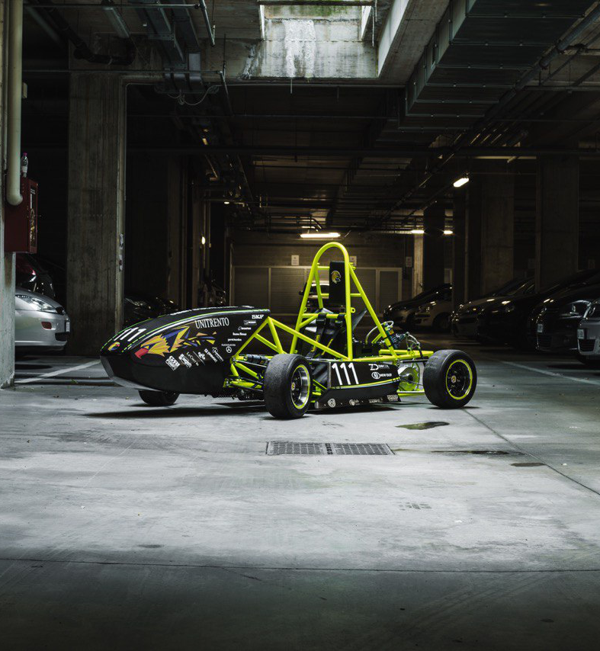
FSAE
Internation racing competition between univeristies
Vehicles developed and realized by students
Eagle Trento racing team was born in 2016
This is our second vehicle: Chimera EVO

Slide 3
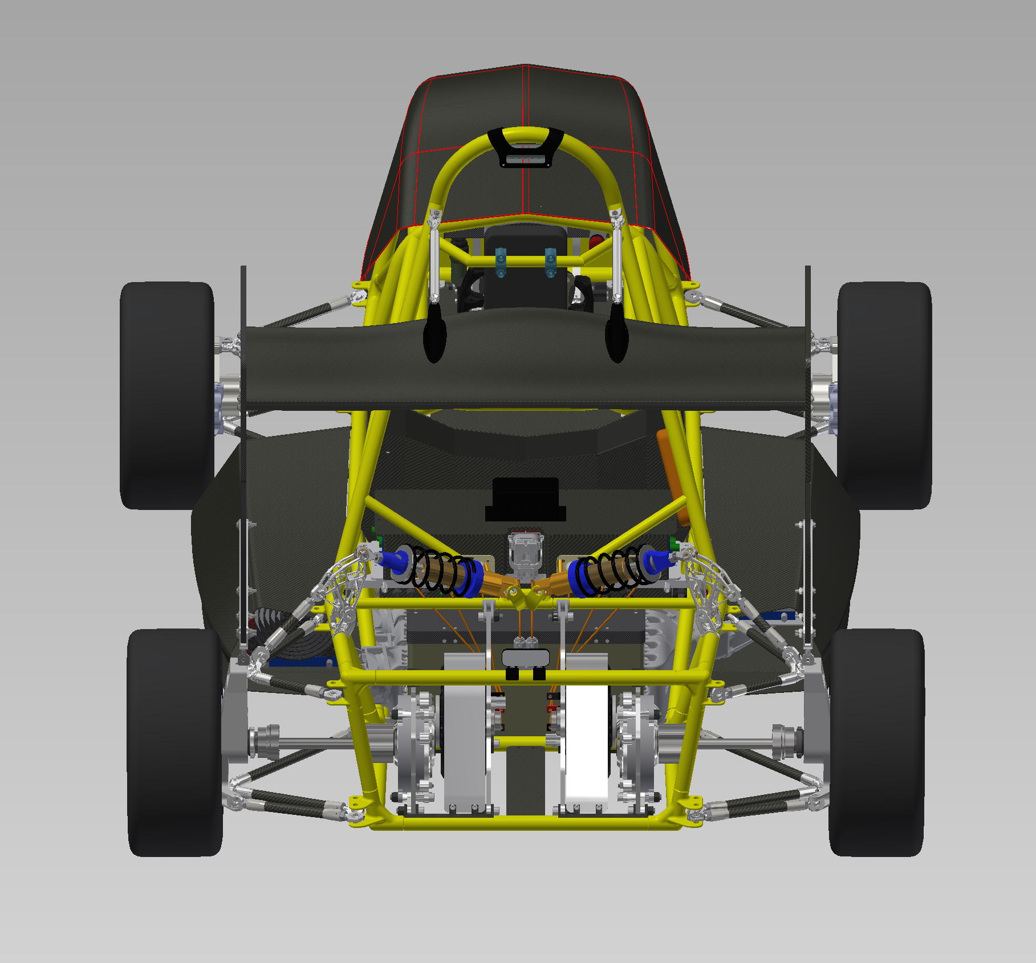
Electrical configuration of Chimera

Slide 4
Battery Management System
Electronic device that monitors a manages an accumulator providing information of:
Total voltage and single cell voltage
State of charge
Temperatures of different states
Input and output current

Slide 5
Battery Management System
Other very important tasks of the BMS:
Manages the Shut Down System to turn off the tractive system in fault cases (Under/Over Voltage, Over Temperature ecc..)
Comunication with the ECU to optimize the parameters to provide the best torque to the electric motors (trought the inverters)
Communication with the ECU to display the information on the steering wheel in real time
Manages of the cooling system of the accumulator analyzing the information about the internal temperatures

Slide 6
Battery Management System
There are 3 different BMS implementation:
Centralized BMS: Single big Master PCB
Distribuited BMS: Master PCB to many Slaves PCB, single communication channel
Hybrid BMS: Master PCB to many Slaves PCB, many communication channels

Slide 7
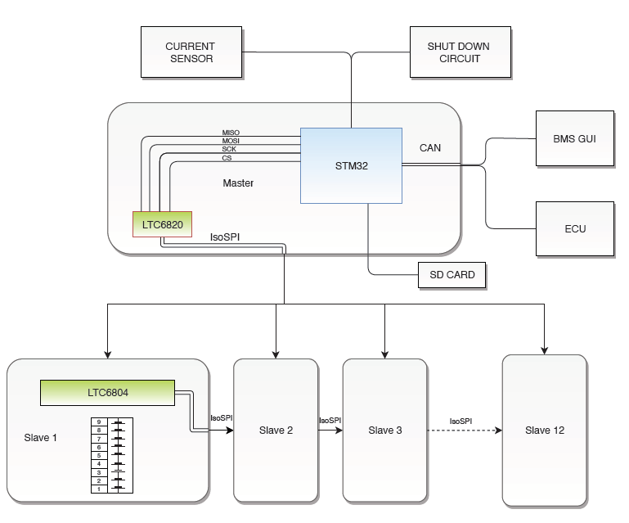
Main architecture of EagleBMS

Slide 8
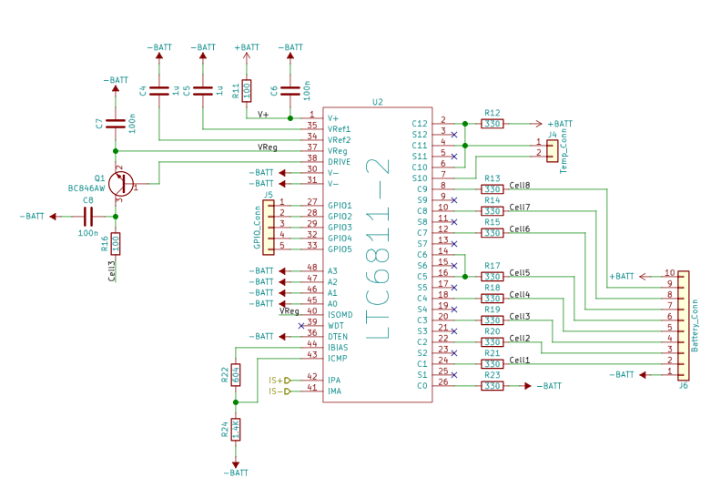
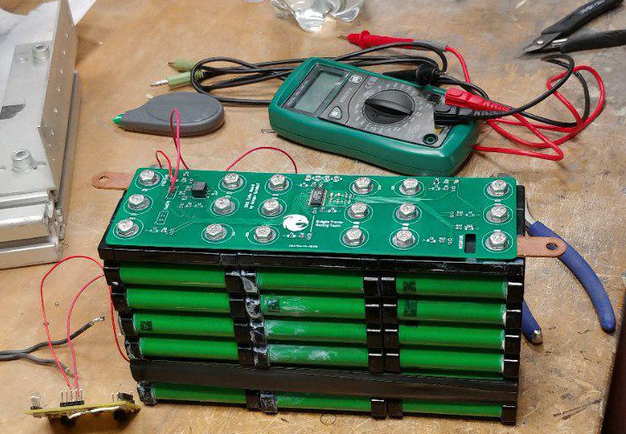
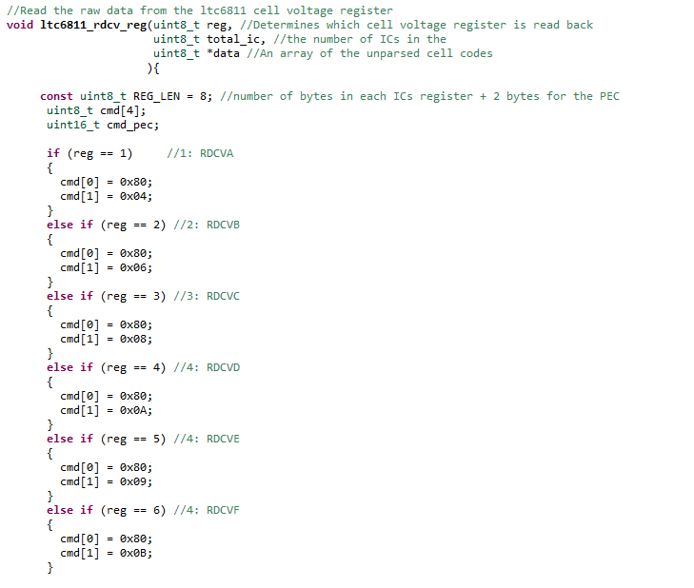
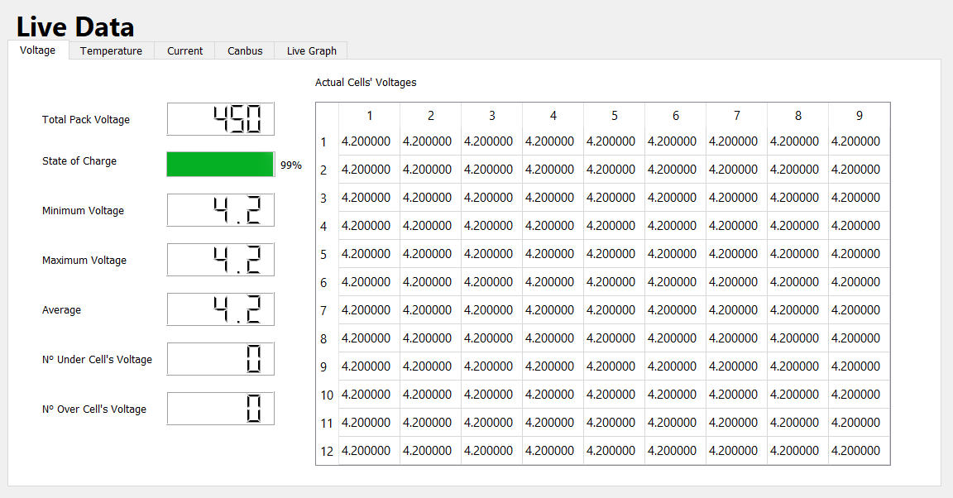
HW development
SW development

Slide 9
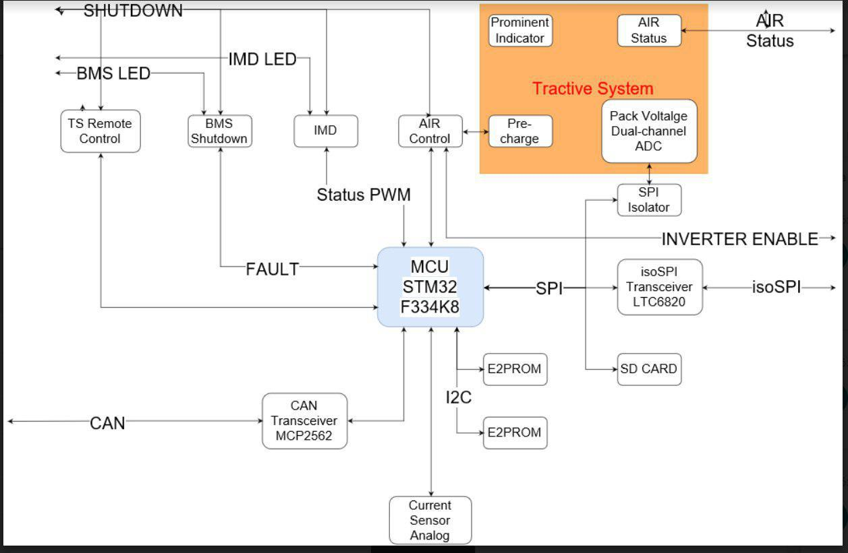

Slide 10
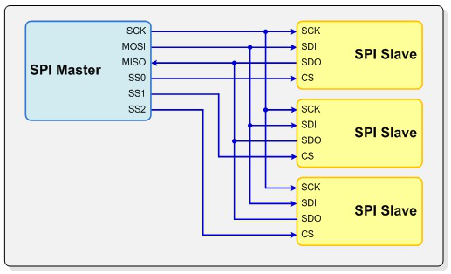
Software development:Data acquisition
Cells voltage and temperature acquired by each LTC6804 and send through isoSPI propetary protocol to LTC6820
These data are transferred via SPI(serial peripherals interface) to the MPU stm32
Each data sent is logged on an SD
MISO(master in slave out):Slave line for sending the data to the master
MOSI(master out slave in):Master line for sending data to peripherals
SCK(serial clock):synchronize data transmission
SS(slave select):enable/disable specific slave device

Slide 11
Software development:Data acquisition
Current data acquired by

Slide 12
Software development:

